Slide 2
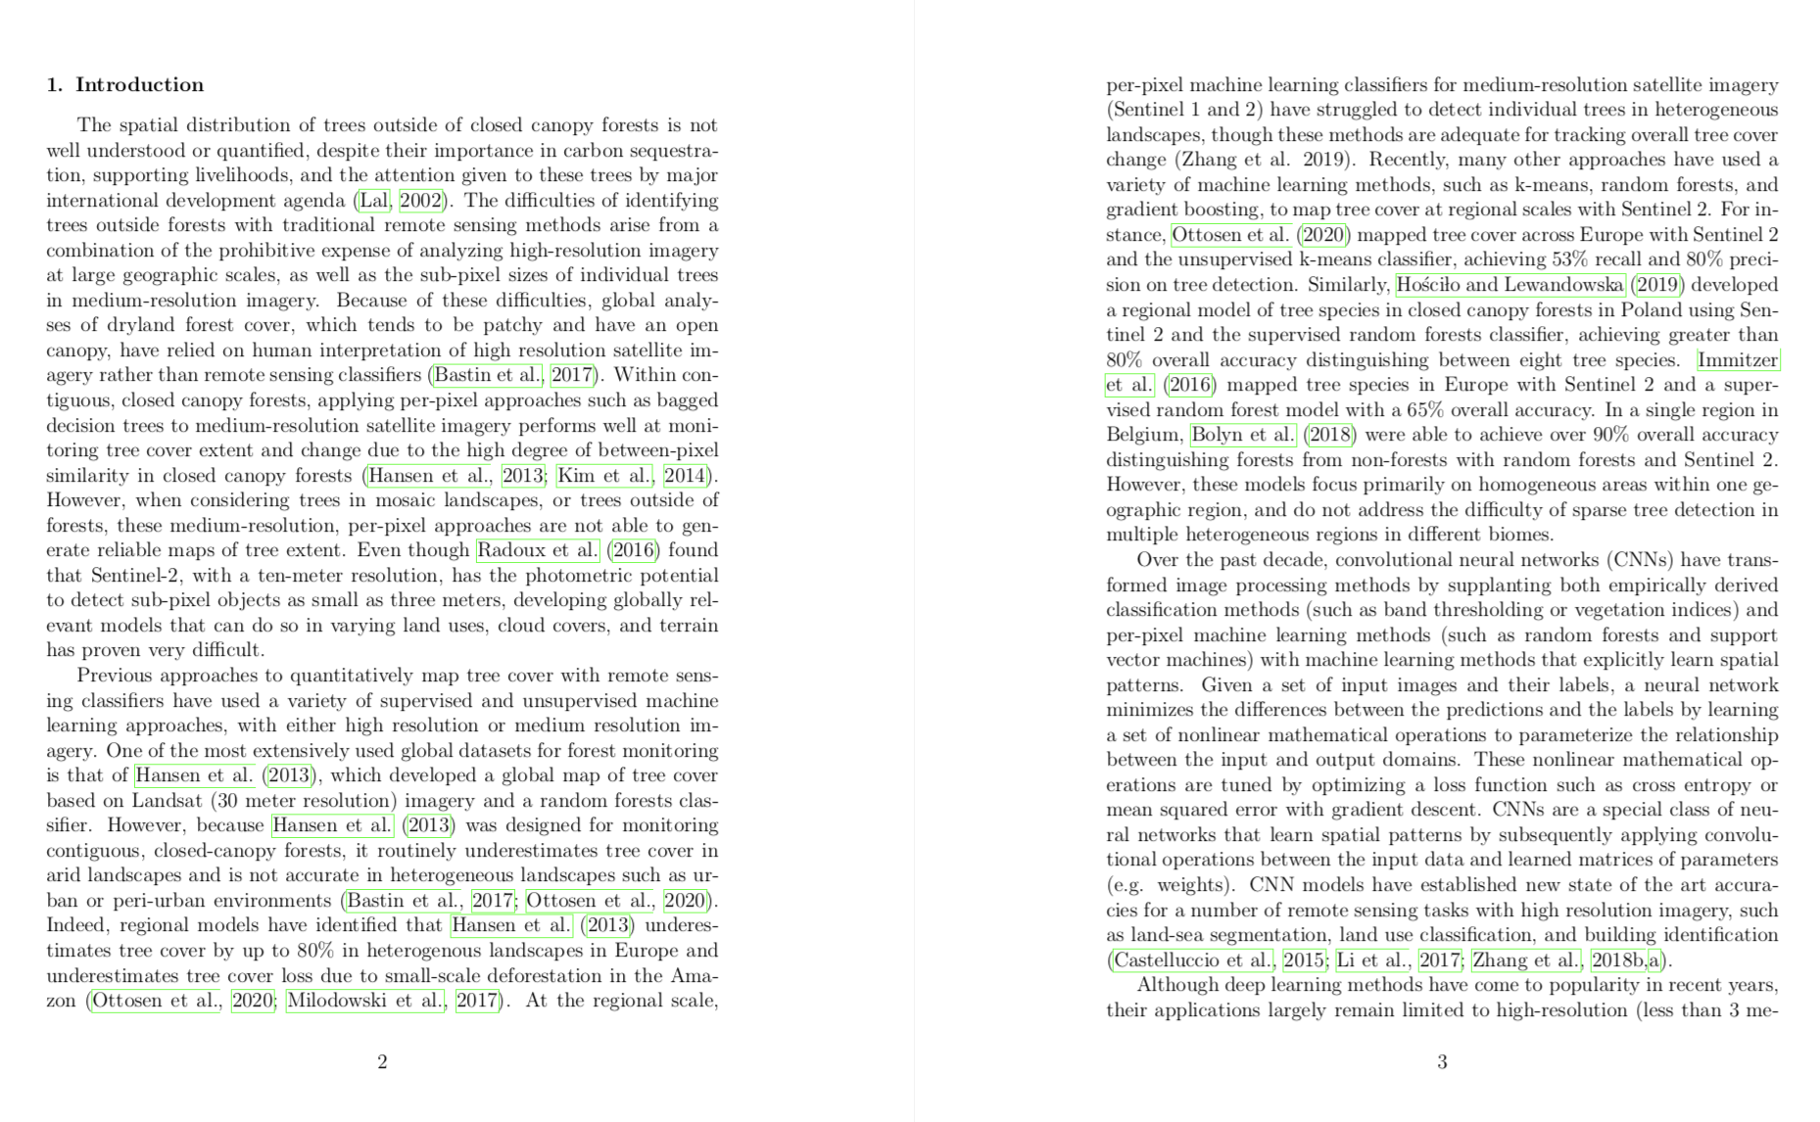

Slide 3
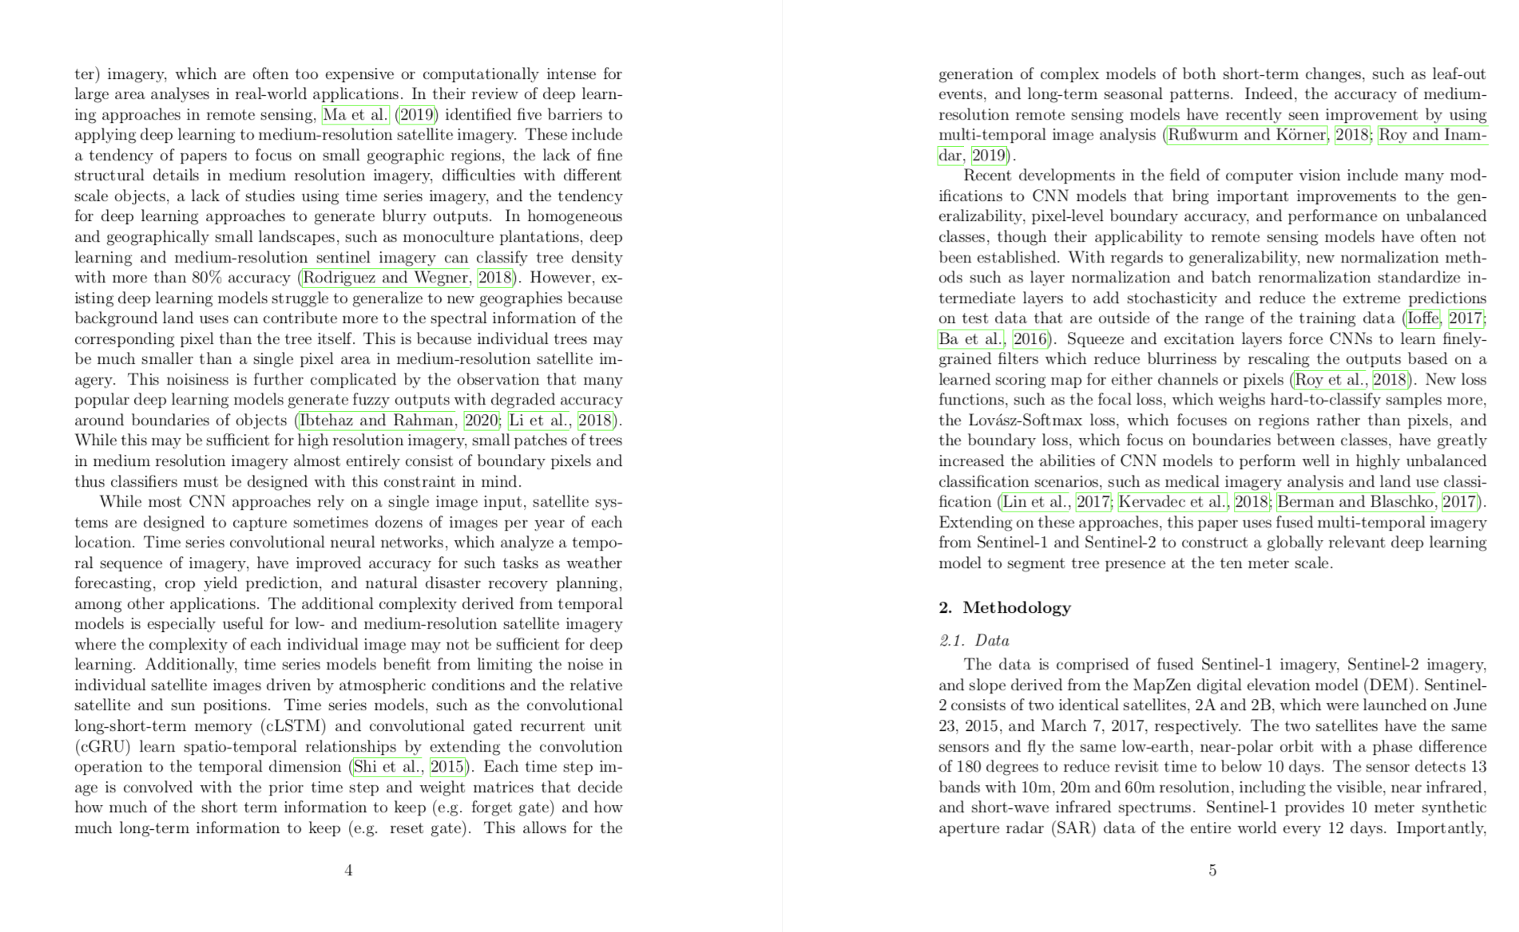

Slide 4
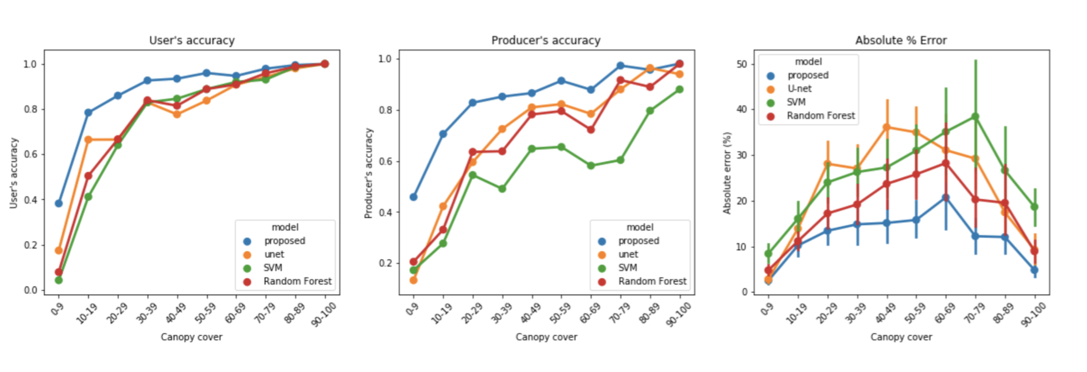

Slide 5
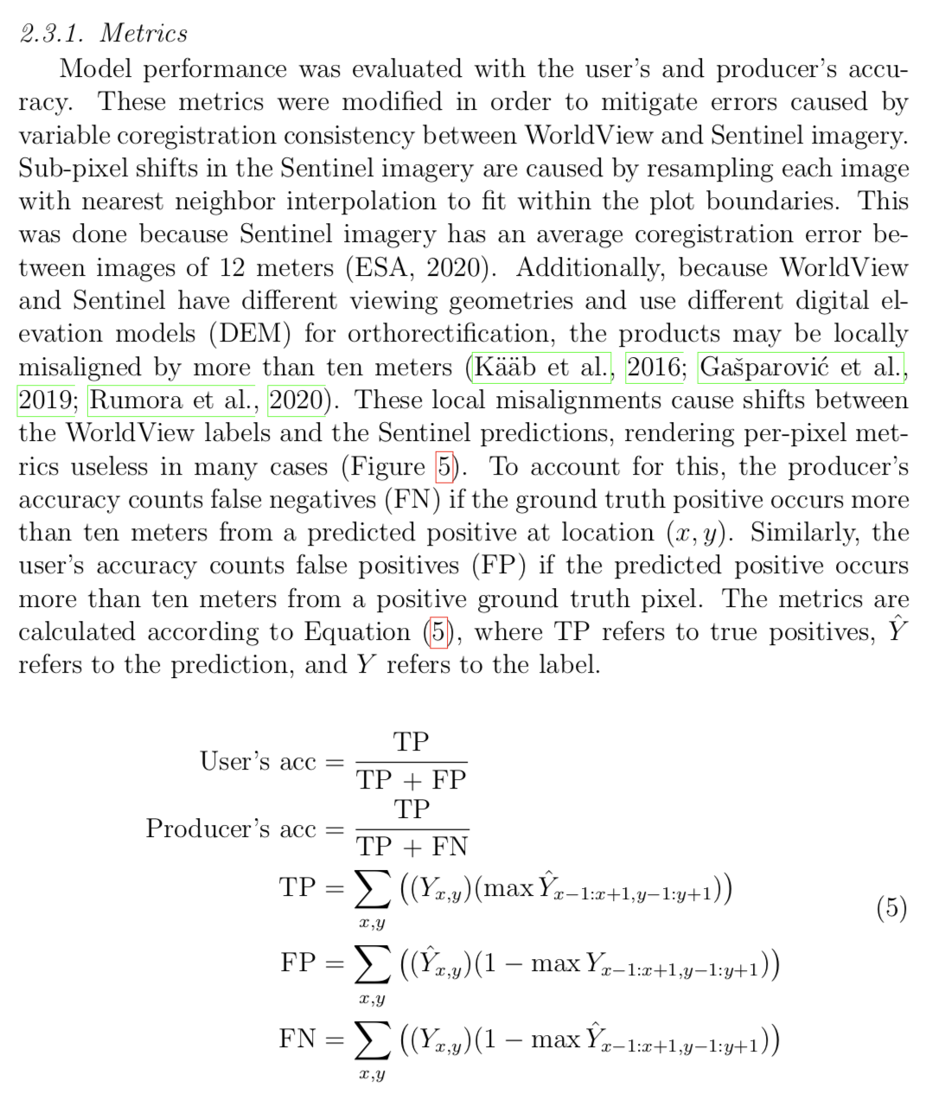

Slide 6
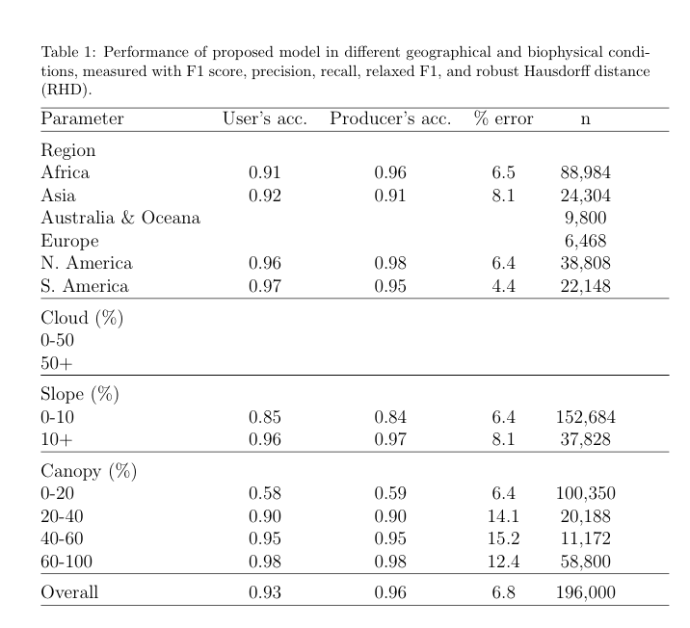
Australia and Europe are undersampled
I have to go in and label more test data and rerun all the test results

Slide 7
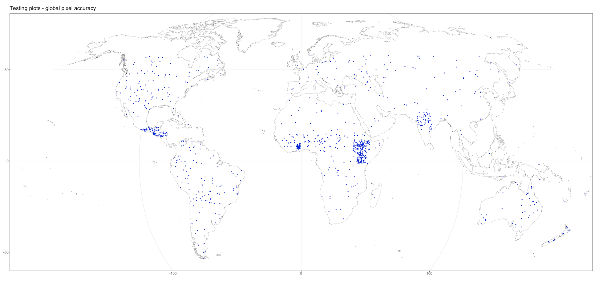
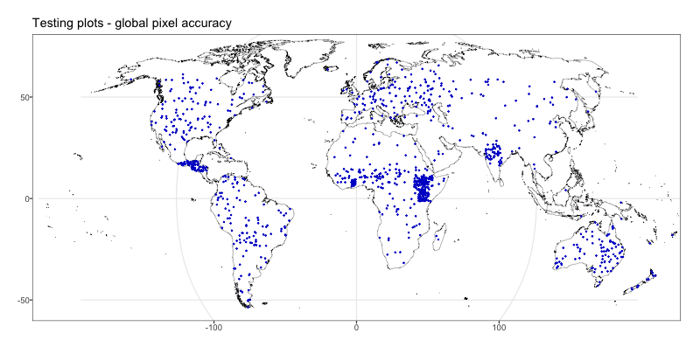

Slide 8
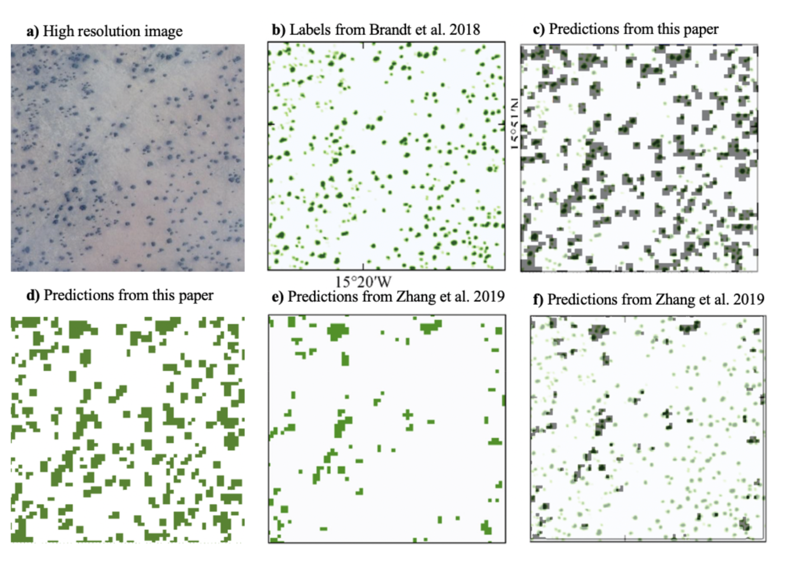

Slide 9
To do list
Finalize comparisons with Bastin
Finalize test metrics after fixing sampling issues
Recreate results figures
Rewrite results section
Write discussion section
Create a python script to recreate all results
Submit paper
Hold a brownbag
Landscape engagement

Slide 10
